Slide 1
CSC 110 Fall 2018 Project
Cardstock Cube Decorated With Turtle Patterns
Choose 2 patterns from those shown from page 3 to the last page (A to Q) & let me know your pattern choices since no 2 students can use the same 2 patterns. Choose 2 colors for the rectangles in each pattern. Write code that uses the turtle module to draw a 4 x 4 array of your first pattern on one of the A faces and the same pattern but with your colors switched on the other A face. Write code that uses the turtle module to draw a 4 x 4 array of your second pattern on one of the B faces and the same pattern but with your colors switched on the other B face. Choose a 4x4 pattern of your choice for the last two faces of the cube. Have the turtle module draw the skeleton for the cube on page 2 – the above patterns should be inside the corresponding cube faces shown on the cube skeleton. Each pattern should extend to the border of the face. See the next page for an example.
Plan on having a top level function that prints the pattern, including the glue tabs, and which has appropriate size and color parameters so that (1) executing this function draws the whole pattern, including the glue tabs, (2) the whole pattern can be made larger or smaller with the size parameter(s) and (3) the colors used can be changed with the color parameter(s). To get full points, you must do all of these things. Look at the video at this link:
https://youtu.be/mzWo0MA43bo
Your turtle code image will be printed directly on an 8.5 in. x 11.0 in. sheet of cardstock using the color laser printer in the faculty computer center – I will provide the white cardstock and I will do the printing. Make sure your turtle image includes the cube skeleton on page 2 since you will need the lines as a guide for folding the cube and the glue tabs for gluing the cube. After doing the printout, I will return the cardstock to you and you can fold and glue the cube which you can keep. Plan on lightly scoring the cardstock with a ruler and a knife to obtain clean folds on the cardstock. I can provide glue for your cube.
In addition to your final cube, you will submit your Python code, a Powerpoint presentation explaining your code and an on-screen voice and video using your Powerpoint charts and your Python code. Please post your video to Youtube and put the link to your video in the title page of your Powerpoint presentation.
All items are due by midnight the Wednesday before finals week. You will receive 2% extra credit per day early for a maximum of 10% extra credit. You will be penalized 5% per day for each day the project is late. No projects will be accepted after the individual final.

Slide 2
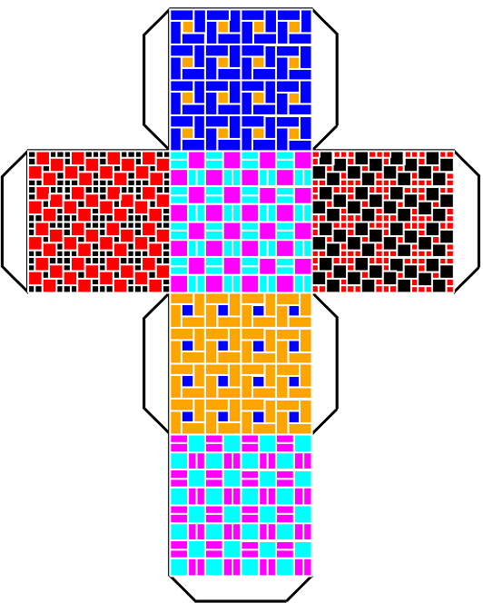

Slide 3
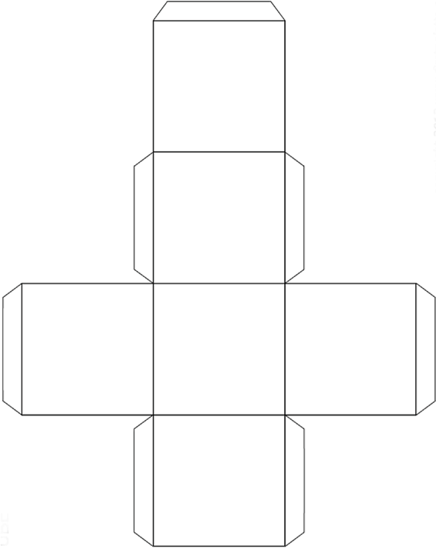
A
B
YOUR PATTERN
A
YOUR PATTERN
B

Slide 4


A
B

Slide 5

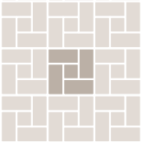
C
D

Slide 6
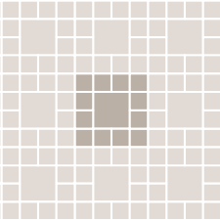

E
F

Slide 7
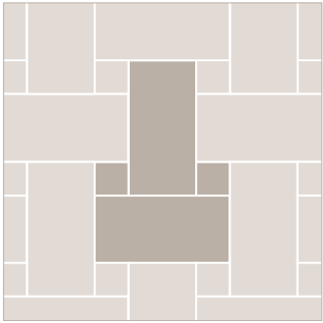

G
H

Slide 8

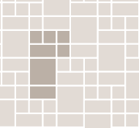
I
J

Slide 9


K
L

Slide 10

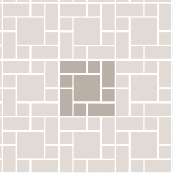
M
N

Slide 11

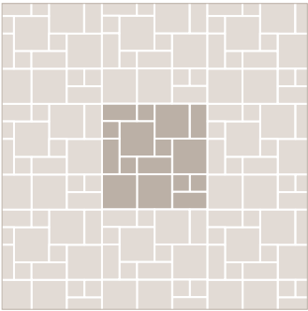
O
P

Slide 12

Q

